Slide 1
Basic statistics(Descriptive statistics)
Mr. Shrikrishna Anand Narvekar
Assitant Professor
Computer Engineering department
Agnel Institute of Technology and Design

Slide 2
Why descriptive statistics
Descriptive statistics are used to summarize and understand data by focusing on what has happened in the past.
Descriptive statistics avoid inferences but, they help us to geta feel of the data.
Sometimes they are good enough to make an inference.

Slide 3
What is descriptive statistics
Descriptive statistics involve using numbers and visuals to summarize and describe data.
Eg : Calculate average salary of employee in a company, chart showing number different employees in different department and their salaries
Numerical descriptions: centre-where the middle value of the data lies.(mean, median, mode)
Variability-Measures that tell you how spread out the data is.( Range ,variance , standard deviation)
Bivariate description-When you study two variables together to see if there’s a relationship.

Slide 4
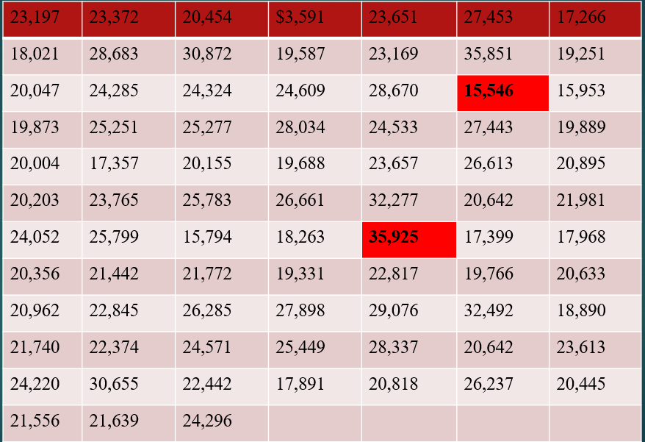
Table-Prices ($) of vehicle sold last month at Whitner Autoplex
Lowest
Highest

Slide 5
Problem
Suppose we want to summarize last month’s sales using selling price/ we want to determine the value around which the selling price tend to cluster-
The data presented in table is raw because it is unprocessed by statistical methods (Any information before it is arranged and analysed is called raw data)
For the purpose of organizing and summarization, we can start with frequency distribution.
Frequency Distribution is a grouping of data

Slide 6
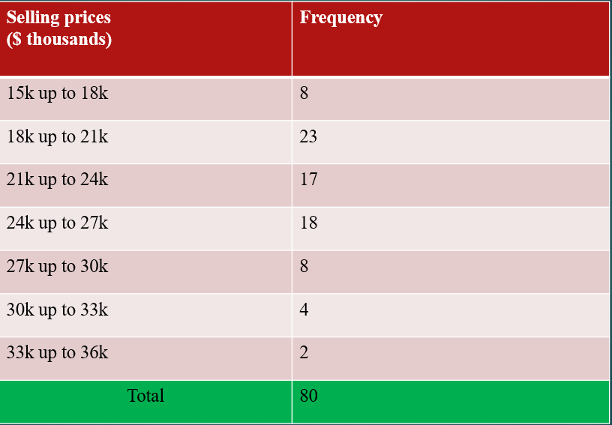
Table-Frequency Distribution of selling prices at Whitner Autoplex (Last Month)

Slide 7
Answer the below questions from the frequency distribution
What is the total number of observations?
Which selling price range has the highest frequency?
Which selling price range has the lowest frequency?
How many cars were sold for less than 21k?
What is the cumulative frequency of cars sold up to 27k?
What percentage of cars were sold in the 24k up to 27k range?
Calculate the midpoint of the 21k up to 24k selling price range.
What is the range of the selling prices?
If you wanted to visualize this data, which type of graph would be most appropriate?

Slide 8
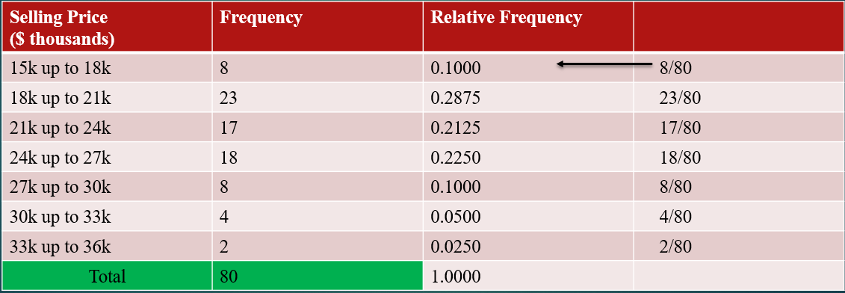
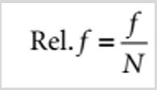
Relative frequency

Slide 9
Graphical representation of distribution
Bar graphs are used for qualitative variables that differ in a kind

Slide 10
Central Tendency
Graphical techniques for organizing and displaying data allow the researcher to make some general observations about the shape and spread of the data, a more complete understanding of the data can be attained by summarizing the data using statistics. It will deal with measures of central tendency, measures of variability, and measures of shape. The computation of these measures is different for ungrouped and grouped data.
Central Tendency is the extent to which the values of a numerical variable group around a typical or central value.
Most variable show a distinct tendency to group around a central value.
When people talk about an “average value” or “middle value ” or “most frequent value ”, they are unfortunately talking about mean, median and mode -three measures of the central tendency.

Slide 11

Mean
The arithmetic mean (typically referred to as the mean) is the most common measure of central tendency.
The mean suggests a typical or central value and serve as the “balance point” or fulcrum in a set of data.
X₁ , X₂,……………Xₙ be the set of n values where ‘n ’ represent size of sample, then the sample mean is given by
$$\bar{X}=\frac{\sum_{i=1}^{n}{X_{i}}}{n}=\frac{X_{1}+X_{2}+⋯+X_{n}}{n}$$

Slide 12
Calculate mean
The dataset represents the number of high-end watches sold per month by a luxury retailer over the past six months:
Q. 1 Calculate the mean (average) number of high-end watches sold per month over the past six months.
Q.2 How many months had sales below the average?
Q.3 How many months had sales greater than or equal to 10?
Q.4 In which month was the highest number of watches sold, and in which month was the lowest?
Q.5 What is the percentage increase in sales from January to May?
Month | Watches Sold
January | 8
February | 10
March | 9
April | 7
May | 12
June | 11
Notes:
Q.1 Mean (Average) = 9.5 watches
Q.2 Number of months with sales below average (9.5) = 3 months (Jan, Mar, Apr)
Q.3 Number of months with sales ≥ 10 = 3 months (Feb, May, Jun)
Q.4 Highest Sales = May (12 watches)
Lowest Sales = April (7 watches)
Difference (May – April) = 5 watches
Q.5 Sure — step-by-step:
Identify values:
January (initial) = 8 watches, May (final) = 12 watches.
Find the change (increase):
$\text{Change}=\text{Final}−\text{Initial}=12−8=4$watches.
Apply percentage increase formula:
$$\text{Percentage} \text{increase}=\frac{\text{Change}}{\text{Initial}}×100=\frac{4}{8}×100.$$
Simplify the fraction:
$\frac{4}{8}=\frac{1}{2}$(dividing numerator and denominator by 4).
Convert to decimal and percent:
$\frac{1}{2}=0.5$.
$0.5×100=50$.
Answer: The sales increased by 50% from January to May (an increase of 4 watches, from 8 to 12).

Slide 13

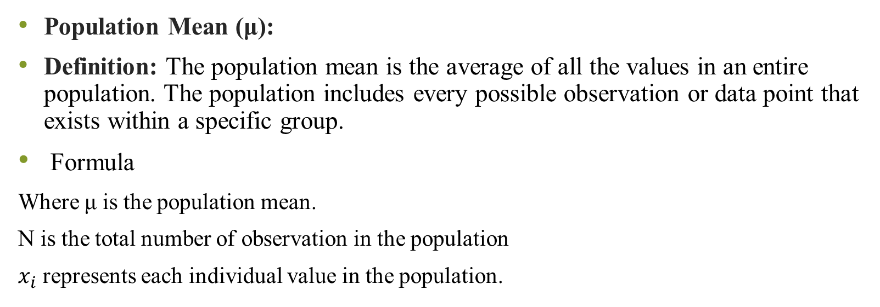
Mean for a Simple Frequency Distribution
Population Mean (μ):
Definition: The population mean is the average of all the values in an entire population. The population includes every possible observation or data point that exists within a specific group.
Formula
Where μ is the population mean.
N is the total number of observation in the population
$x_{i}$ represents each individual value in the population.
Used when you have data for every member of the population.
Example: If you have the exact income data for every resident of a city, the mean calculated from this data is the population mean.

Slide 14

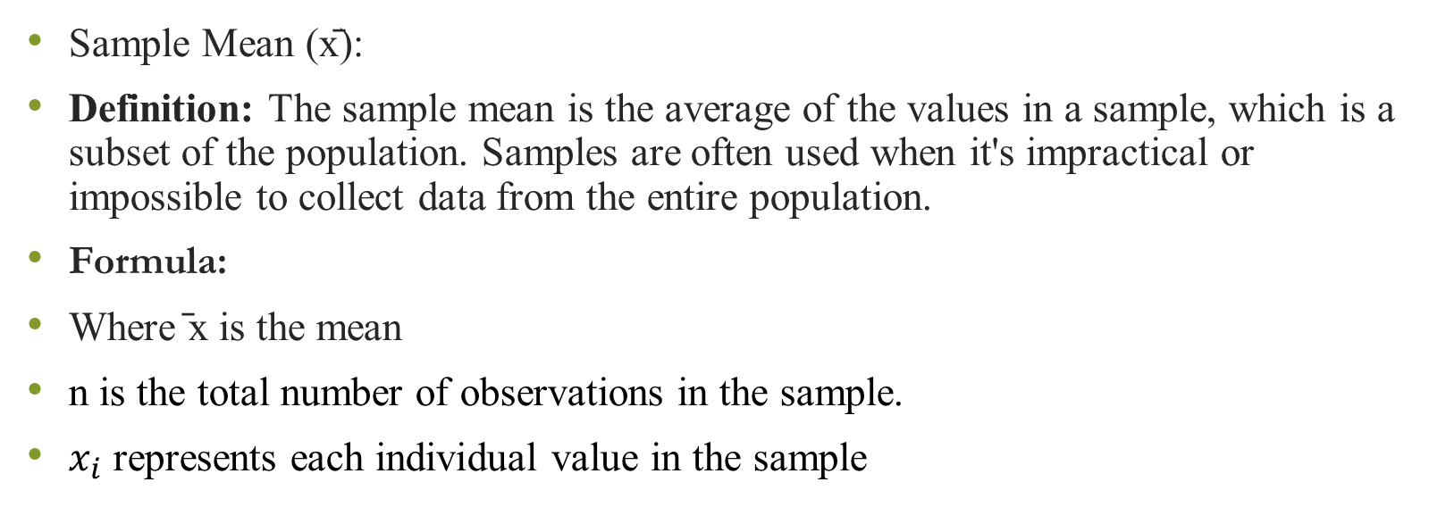
Mean for a Simple Frequency Distribution
Sample Mean (x̄):
Definition: The sample mean is the average of the values in a sample, which is a subset of the population. Samples are often used when it's impractical or impossible to collect data from the entire population.
Formula:
Where ̄x is the mean
n is the total number of observations in the sample.
$x_{i}$ represents each individual value in the sample
Usage: Used when you have data for only part of the population
Example: If you survey 100 residents out of a city of 10,000 to estimate the average income, the mean calculated from this survey is the sample mean.

Slide 15
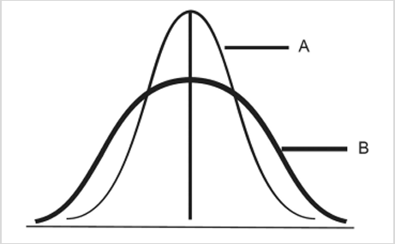
Dispersion or variability
Variability is the amount of spread among the scores.
Measures of variability provide information about how similar or different the scores are in relationship to other scores in the distribution
Ways of expressing variability
Range
Variance
Standard deviation
Notes:
Analyze the differences between Curve A and Curve B given in the figure below in terms of central tendency and variability, and explain their potential implications in a business context.

Slide 16
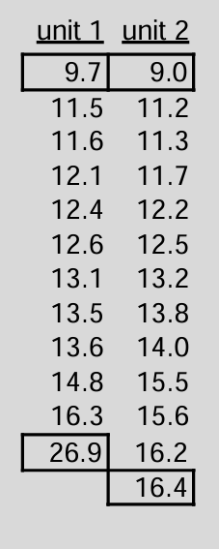
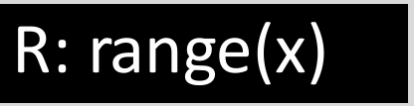
Range
Max - Min

Slide 17
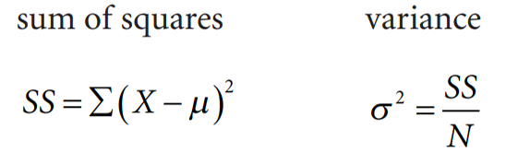
Variance
Take deviation from Mean-It can be zero sometimes
Hence take square of deviation from mean→ Take average of that
Average mean squared distance is variance
Variance (𝜎2) in statistics is a measurement of the spread between numbers in a data set.
That is, it measures how far each number in the set is from the mean and therefore from every other number in the set
Sum of Squares gives you a measure of total variability

Slide 18
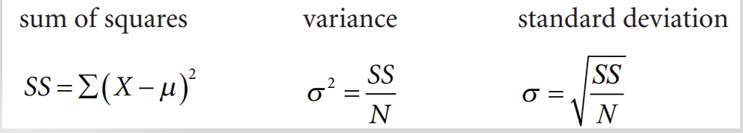
Standard deviation
The standard deviation is based on deviation scores.
To deviate means to depart from a standard, the standard in this case being the mean
Square root of variance
Its symbol is sigma σ(the Greek letter sigma)
The Standard Deviation is a measure of how spread out numbers are

Slide 19
Scenario: Quality Control in Manufacturing
Rod | Length(cm)
1 | 99.8
2 | 100.2
3 | 99.7
4 | 100.1
5 | 100
6 | 100.3
7 | 99.9
8 | 100.4
9 | 99.6
10 | 100
You are part of the quality control team in a company
that manufactures metal rods used in construction.
To ensure that the rods meet the required standards,
you need to assess the consistency of their lengths.
You randomly select 10 rods from a production
batch and measure their lengths (in centimeters):
Calculate mean, variance and standard deviation
Notes:
1. Mean Length
Formula:
$$\text{Mean}=\frac{\sum{x_{i}}}{n}$$
Where:
$x_{i}$= each rod length
$n=10$(number of rods)
$$\text{Mean}=\frac{99.8+100.2+99.7+100.1+100.0+100.3+99.9+100.4+99.6+100.0}{10}$$
$$\text{Mean}=\frac{1000.0}{10}=100.0 \text{cm}$$
✅ Mean Length = 100.0 cm
2. Standard Deviation (Sample SD)
Formula:
Step 1: Find deviations from the mean (100.0 cm):
(99.8 – 100.0) = -0.2
(100.2 – 100.0) = 0.2
(99.7 – 100.0) = -0.3
(100.1 – 100.0) = 0.1
(100.0 – 100.0) = 0
(100.3 – 100.0) = 0.3
(99.9 – 100.0) = -0.1
(100.4 – 100.0) = 0.4
(99.6 – 100.0) = -0.4
(100.0 – 100.0) = 0
Step 2: Square each deviation and sum:
$$\left(−0.2{\left.)\right.}^{2}+\left(0.2{\left.)\right.}^{2}+\left(−0.3{\left.)\right.}^{2}+\left(0.1{\left.)\right.}^{2}+\left(0{\left.)\right.}^{2}+\left(0.3{\left.)\right.}^{2}+\left(−0.1{\left.)\right.}^{2}+\left(0.4{\left.)\right.}^{2}+\left(−0.4{\left.)\right.}^{2}+\left(0{\left.)\right.}^{2}\right.\right.\right.\right.\right.\right.\right.\right.\right.\right.$$
$$=0.04+0.04+0.09+0.01+0+0.09+0.01+0.16+0.16+0=0.60$$
Step 3: Divide by $n−1=9$:
$$\frac{0.60}{9}=0.0667$$
Step 4: Take the square root:
$$s=\sqrt{0.0667}≈0.258 \text{cm}$$
✅ Standard Deviation ≈ 0.26 cm

Slide 20
Central Tendency Analysis
  Compute the Mean Length of the sampled rods to determine the representative average length of the production batch.
Variation Analysis
  Calculate the Standard Deviation of the rod lengths to assess the degree of variation and consistency in the manufacturing process.
Quality Control Interpretation (Optional, to deepen analysis)
  Based on the calculated mean and standard deviation, evaluate whether the production process demonstrates high precision and consistency in meeting the required specifications.
Notes:
Final Interpretation (Quality Control View):
The average rod length is 100.0 cm, exactly matching the target.
The standard deviation is 0.26 cm, which is very small, indicating high precision and consistency in the manufacturing process.

Slide 21
What does standard deviation tells us
Larger values indicate greater variability.
Smaller values indicate less variability.
A standard deviation of 0 would indicate no variability (i.e., that everyone scored at the mean)

Slide 22
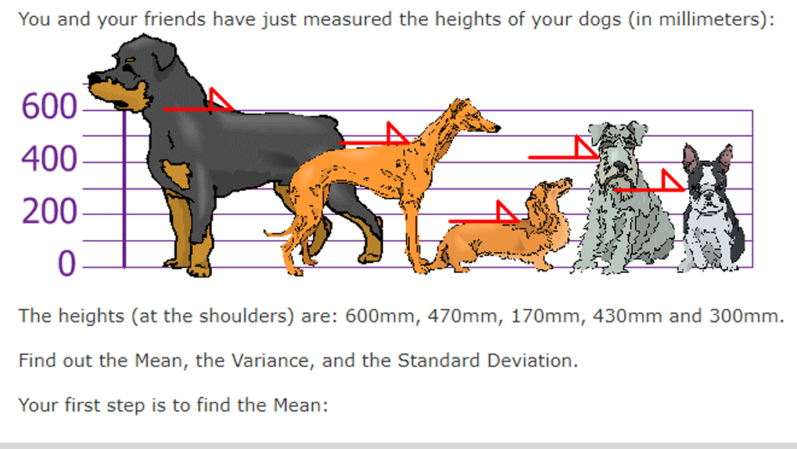
Calculate the mean, variance, and standard deviation for the given data set
comment what does standard deviation tells us

Slide 23
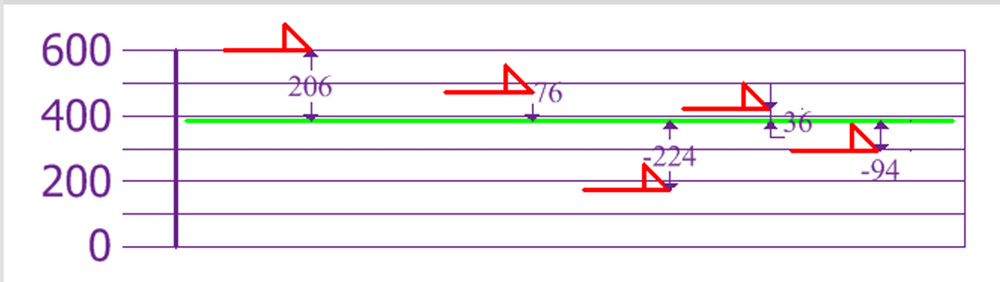
calculate each dog's difference from the Mean

Slide 24
Measures of shapes
Measure of shape are tools that can be used to describe the shape of the distribution of data
Skewness is when distribution is asymmetrical or lacks symmetry.
When we work with statistical problem, we must decide whether to use the mean, the median or the mode as a measure of central tendency. Symmetrical distributions that contain only one mode always have the same value for the mean, median and the mode. In that context, the choice is easy.

Slide 25
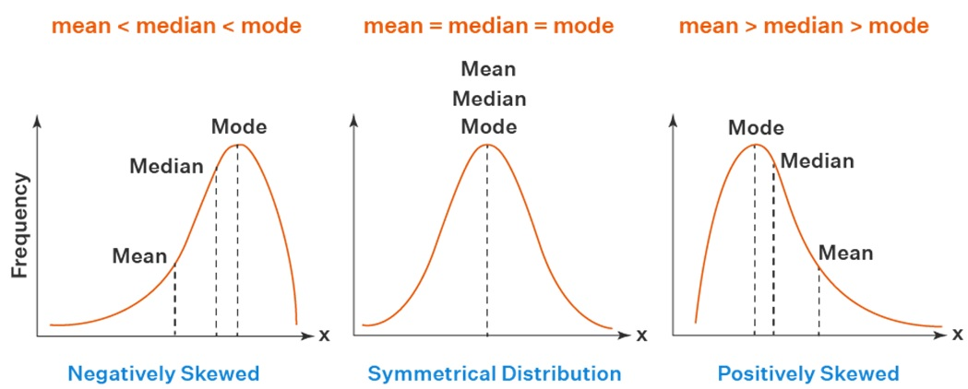
When the distributions are positively skewed or negatively skewed, the median is often the best measure of location because it is always between the mean and the mode
The median is not as highly influenced by the frequency of occurrence of a single value as is the mode nor it is affected by extreme values as is the mean.

Slide 26
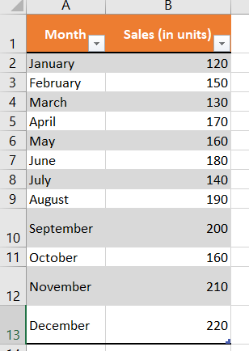
Simple descriptive statistics
Suppose you have monthly sales data as shown below
From the monthly sales data given find
Count, Sum ,Min, Max, Average, variance and
standard deviation
Simple descriptive statistics

Slide 27
Questions
What is the total sales over 12 months?
Is there any variability in monthly sales?
Which is the most frequently occurring sales figure in the data?
What is the variance of the data? What does variance indicate?
Is this distribution symmetrical?
Comment on the monthly sales by comparing mean and standard deviation?

Slide 28
Z-score
The standard deviation describes an average amount that an entire distribution of scores deviates from the mean.
A Z-Score represents the number of standard deviation a value is above or below mean of set of numbers when data is normally distributed
i.e. if Z-score is negative, the raw value (x) is below mean.
If Z-score is positive, the raw value(x) is above mean.

Slide 29
Significance in data analytics
Standardization of data
Detecting outliers
Understanding relative position
Probability & Normal Distribution
Feature Scaling in Machine Learning
Notes:
Standardization of Data
Z-scores transform different datasets (with different units or scales) into a common scale.
Useful for comparing values across datasets.
Example: Comparing test scores in Math (out of 100) vs. English (out of 50).
Detecting Outliers
If $∣Z∣>3$, the value is usually considered an outlier.
Helps in data cleaning and preprocessing.
Understanding Relative Position
A positive Z-score means the value is above the mean,
A negative Z-score means the value is below the mean.
Example: A Z-score of +2 means the value is 2 standard deviations above the average.
Probability & Normal Distribution
In normally distributed data, Z-scores help calculate the probability of occurrence.
Example: In a standard normal distribution, about 68% of values fall between Z = -1 and +1.
Feature Scaling in Machine Learning
Z-score normalization (a.k.a. standardization) is widely used to prepare data before applying ML models (e.g., KNN, SVM).
Ensures features with large ranges don’t dominate smaller ones.

Slide 30
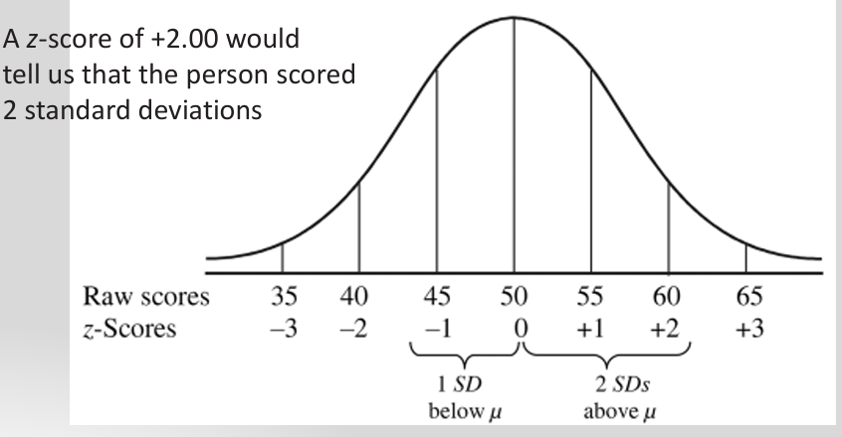
Z-score

Slide 31
Why standardize ?
It can help us make decisions about our data.
Example: A professor is marking a test. Here are the students' results (out of 60 points): 20, 15, 26, 32, 18, 28, 35, 14, 26, 22, 17 Most students didn't even get 30 out of 60, and most will fail. The test must have been really hard, so the Prof decides to Standardize all the scores and only fail people more than 1 standard deviation below the mean.
The Mean is 23, and the Standard Deviation is 6.6, and these are the Standard Scores:-0.45,-1.21, 0.45, 1.36, -0.76, 0.76, 1.82,-1.36, 0.45, -0.15, -0.91

Slide 32
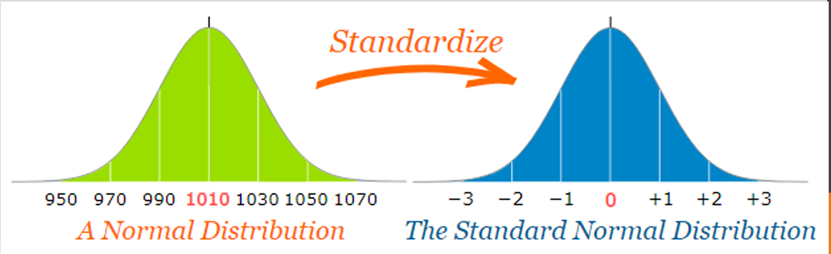
Standardizing Normal distribution
Standardizing a normal distribution is a process that involves converting a normal distribution into the standard normal distribution, which has a mean of 0 and a standard deviation of 1. This transformation allows us to compare different normal distributions and use standard normal distribution tables (z-tables) for various statistical purposes.

Slide 33
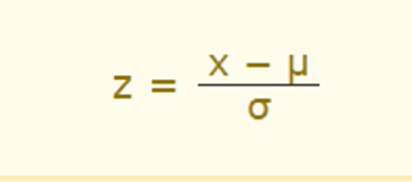
Z-score Formula
Z is the "z-score" (Standard Score)
X is the value to be standardized
μ('mu") is the mean
σ("sigma") is the standard deviation

Slide 34
A survey of daily travel time had these results (in minutes): 26, 33, 65, 28, 34, 55, 25, 44, 50, 36, 26, 37, 43, 62, 35, 38, 45, 32, 28, 34 The Mean is 38.8 minutes, and the Standard Deviation is 11.4 minutes Convert the values to z-scores ("standard scores").
To convert 26:
first subtract the mean: 26 − 38.8 = −12.8
then divide by the Standard Deviation: −12.8/11.4 =−1.12
So 26 is −1.12 Standard Deviations from the Mean

Slide 35
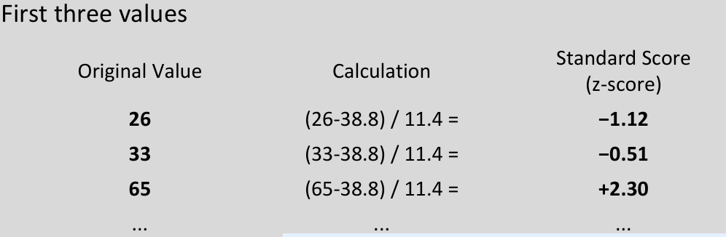
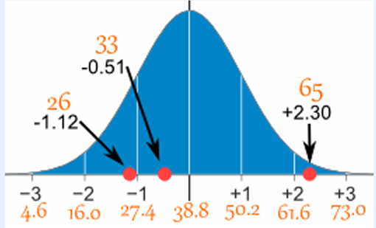

Slide 36
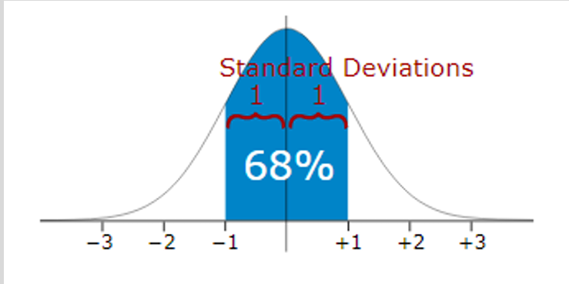
We can expect about 68% of values to be within plus-or-minus 1 standard deviation

Slide 37
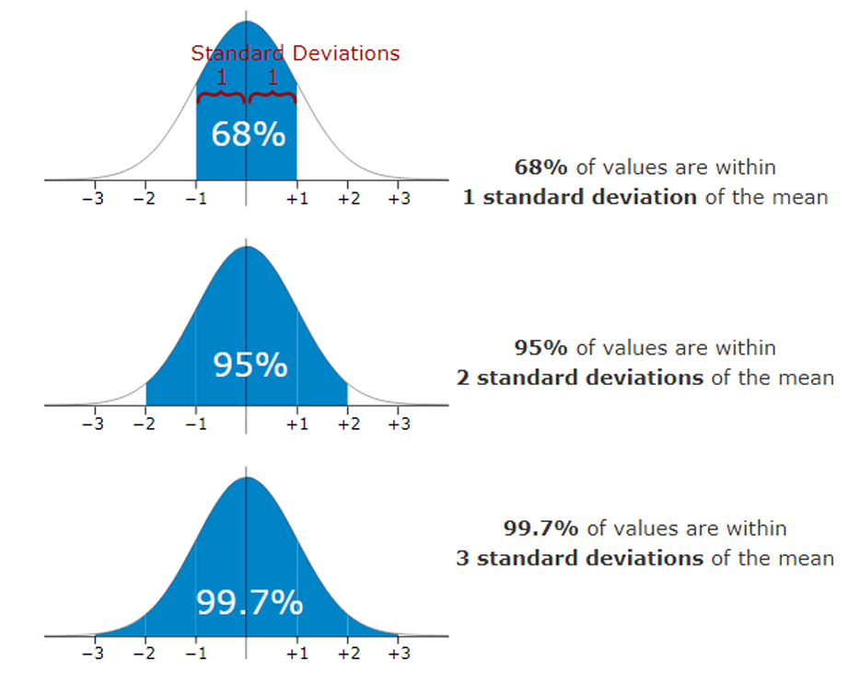

Slide 38
Numerical solved in the book
For the dataset that is normally distributed with a mean of 50 a d standard deviation of 10, suppose a statistician wants to determine the z-score for a value of 70. What is the z-score and what does it signifies?
According to the Human resource report , a worker in the industrial countries spends on average of 419 minutes a day on the job. Suppose the standard deviation of the time spend on the job is 27 minutes and worker spend 400 minutes on the job. What would that workers z-score be , and what it tells the researcher?
Notes:
Q1: Dataset with mean = 50, SD = 10, Value = 70
Step 1: Formula
$$Z=\frac{X−μ}{σ}$$
Step 2: Substitution
$$Z=\frac{70−50}{10}=\frac{20}{10}=2.0$$
Step 3: Interpretation
A z-score of 2.0 means the value 70 lies 2 standard deviations above the mean.
In a normal distribution:
About 95% of data lies within ±2 SD.
So this value is high but still within the expected range, not an outlier.
Comment: This tells the statistician that 70 is higher than the average (50), and only about 2.5% of values will exceed it (since area above z = 2 ≈ 0.0228).
Q2: Worker’s time on the job
Mean ($μ$) = 419 minutes
Standard Deviation ($σ$) = 27 minutes
Value ($X$) = 400 minutes
Step 1: Formula
$$Z=\frac{X−μ}{σ}$$
Step 2: Substitution
$$Z=\frac{400−419}{27}=\frac{−19}{27}≈−0.70$$
Step 3: Interpretation
A z-score of -0.70 means the worker spends 0.7 standard deviations below the average time.
This is not unusual, because |z| < 2.
Comment: The worker’s time is a bit below average but still within the normal range of variation. The researcher can conclude this worker’s behavior is slightly less than typical, but not abnormal compared to the population.
Behavioral interpretation:
The worker’s job time is a bit shorter than typical, but not unusual enough to raise immediate concern.
It could reflect minor variations like leaving slightly early, fewer tasks on hand, or personal work style.
It does not indicate underperformance or disengagement by itself.
✅ Final Answers
Z = 2.0 (value = 70) → 2 SD above mean; rare but not extreme.
Z ≈ -0.70 (value = 400) → 0.7 SD below mean; quite typical, not unusual.

Slide 39
Covariance
Describes how much two variables change together.
Covariance measures how much the movement in one variable predicts the movement in a corresponding variable.
It tells only about the direction . i.e. if one variable is increasing then other variable may increase or decrease.

Slide 40
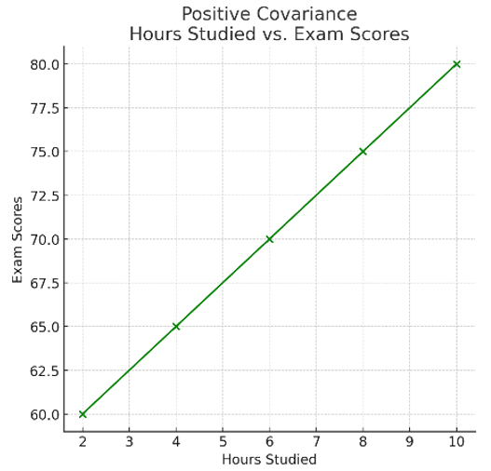
Types of covariance
Positive covariance
Student | Hours | Marks
A | 2 | 60
B | 4 | 65
C | 6 | 70
D | 8 | 75
E | 10 | 80
Both the variables move in the same direction. Here, the variables show similar behaviour.

Slide 41
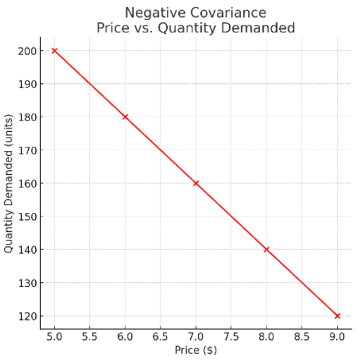
Types of covariance
Negative Covariance
Price($) | Quantity Demanded
5 | 200
6 | 180
7 | 160
8 | 140
9 | 120
Both the variables move in opposite direction

Slide 42
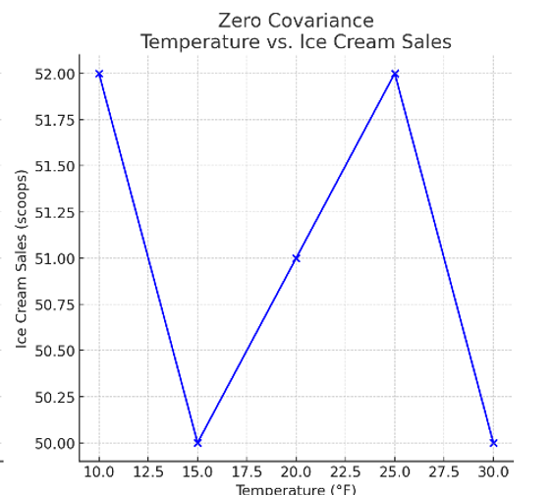
Types of covariance
Temp | Ice cream sales
30°F | 50 scoops
25°F | 52 scoops
20°F | 51 scoops
15°F | 50 scoops
10°F | 52 scoops
Zero (No) Covariance: No clear relationship between the temperature and ice cream sales

Slide 43
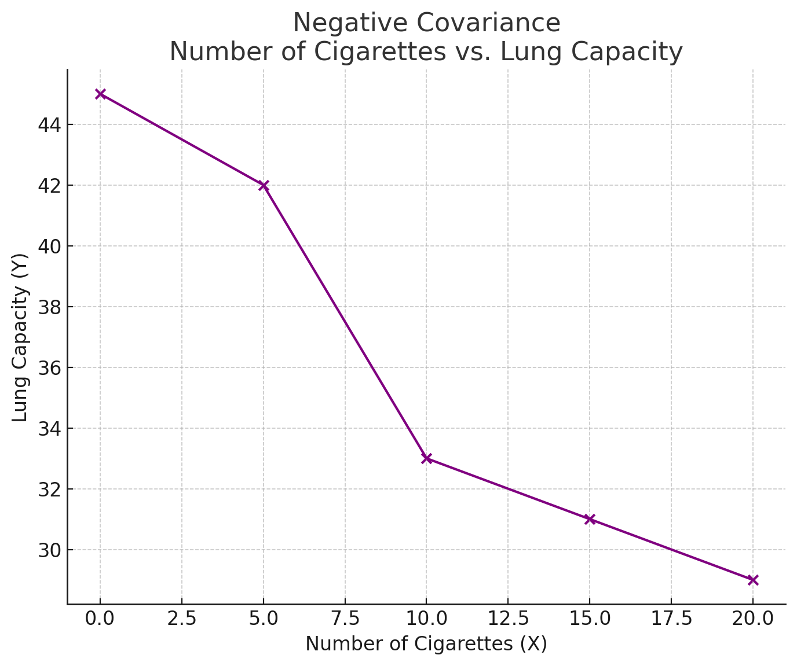
Example
Example: Investigate relationship between cigarette smoking and lung capacity
N | Cigarettes | Lung Capacity (Y )
1 | 0 | 45
2 | 5 | 42
3 | 10 | 33
4 | 15 | 31
5 | 20 | 29

Slide 44
Smoking Vs Lung Capacity
Observe that as smoking exposure goes up, corresponding lung capacity goes down.
Variables covary inversely
Covariance and correlation quantify relationship
Variables that covary inversely, like smoking and lung capacity, tend to appear on opposite sides of the group means
When smoking is above its group mean, lung capacity tends to be below its group mean.

Slide 45
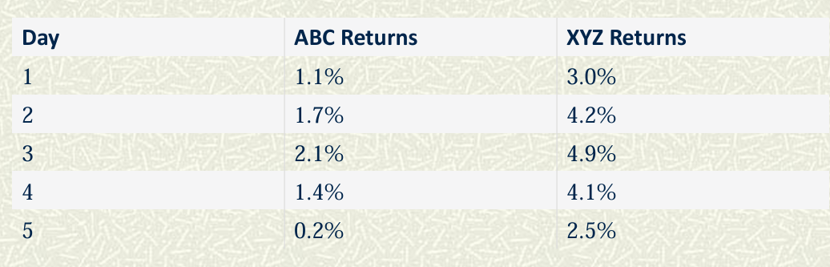
Exercise: An investor is analyzing the returns of two stocks, ABC Ltd. and XYZ Ltd., over a period of 5 days to understand how the two assets move in relation to each other. The daily returns (in %) are given below:
Notes:
You computed the sample means (in percent):
Mean(ABC) = (1.1 + 1.7 + 2.1 + 1.4 + 0.2) / 5 = 1.30 (%)
Mean(XYZ) = (3 + 4.2 + 4.9 + 4.1 + 2.5) / 5 = 3.74 (%)
Then you computed deviations and their products:
Daywise products you listed:
Day1: (1.1−1.30)(3.0−3.74) = (−0.20)(−0.74) = +0.148
Day2: (1.7−1.30)(4.2−3.74) = (0.40)(0.46) = +0.184
Day3: (2.1−1.30)(4.9−3.74) = (0.80)(1.16) = +0.928
Day4: (1.4−1.30)(4.1−3.74) = (0.10)(0.36) = +0.036
Day5: (0.2−1.30)(2.5−3.74) = (−1.10)(−1.24) = +1.364
Sum of products = 2.66
Sample covariance (using n−1 = 4):
$${\text{Cov}}_{\%}=\frac{2.66}{4}=0.665$$
So in percent units the sample covariance is 0.665 (percent²)
Interpretation
The covariance is positive, meaning when ABC’s returns increase, XYZ’s returns also tend to increase.

Slide 46
Correlation
Correlation is a measure that determines the degree to which two or more random variables move in sequence.
Movement of one variable causes movement of other variable variables Correlated.

Slide 47
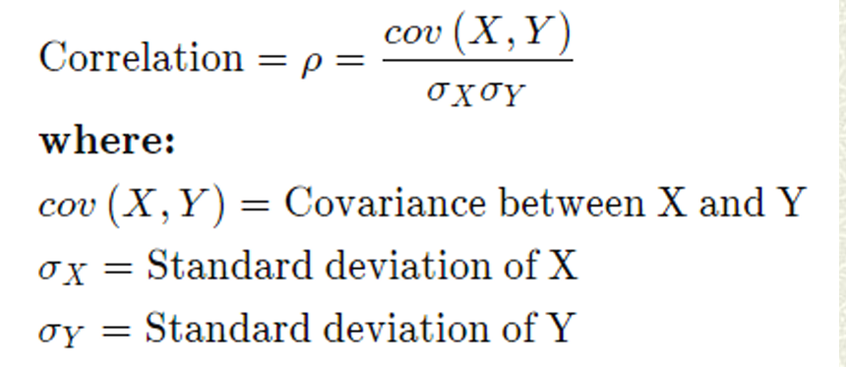
Correlation Calculation

Slide 48
Correlation Calculation
If the correlation is 1, they move perfectly together.
If the correlation is -1, the variables move perfectly in opposite directions.
If the correlation is 0, then the two variables move in random directions from each other

Slide 49
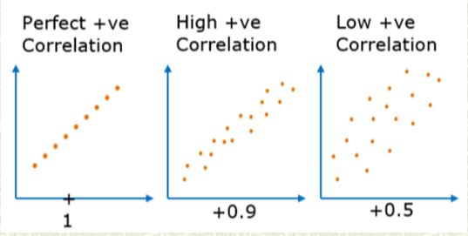
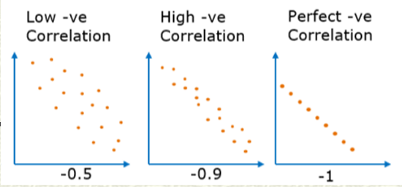

Slide 50
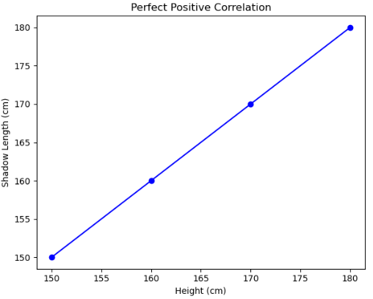
Types of Positive Correlation
Perfect Positive Correlation
Example: Height and shadow length at a fixed time of day.
Description: As height increases, shadow length also increases proportionally. The relationship is perfectly linear, with all data points lying on a straight line
Data Points:
  (150, 150)
  (160, 160)
  (170, 170)
  (180, 180)

Slide 51
2. High Positive Correlation
Example: Study hours and exam scores.
Description: Generally, as study hours increase, exam scores tend to increase, though not perfectly. There is a strong positive relationship, but not all points lie on the straight line.
Correlation Coefficient: r close to 1 (e.g., 0.8 or 0.9)

Slide 52
3. Low Positive Correlation
Example: Age and job satisfaction.
Description: As age increases, job satisfaction slightly increases, but the relationship is weak. The points are more scattered around a line that has a positive slope.
Correlation Coefficient: r is positive but closer to 0 (e.g., 0.3 or 0.4)

Slide 53
Explain the types of correlation with example 6 marks

Slide 54
Practical organizational scenario
A B2B sales organization wants to check how the number of qualified outreach calls per sales rep per day (X) relates to daily closed deals per rep (Y). Leadership suspects a direct proportional relationship and wants to (a) quantify how strong it is, (b) produce a forecasting rule to plan staffing, and (c) decide whether increasing outreach will scale conversions.

Slide 55
Rep / Day | Qualified calls per rep (X) | Closed deals per rep (Y)
A | 4 | 5
B | 8 | 10
C | 12 | 15
D | 16 | 20
Problem: Are closed deals strongly correlated with number of qualified calls?
Notes:
1) Sales example (same data) — do the math step-by-step
Data (per rep per day)
X (qualified calls) = 4, 8, 12, 16
Y (closed deals) = 5, 10, 15, 20
n = 4
Step A — means
$$\overset{ˉ}{X}=\frac{4+8+12+16}{4}=\frac{40}{4}=10$$
$$\overset{ˉ}{Y}=\frac{5+10+15+20}{4}=\frac{50}{4}=12.5$$
Step B — deviations and products
iXY$X−\overset{ˉ}{X}Y−\overset{ˉ}{Y}\left(X−\overset{ˉ}{X}\right)\left(Y−\overset{ˉ}{Y}\right)\left(X−\overset{ˉ}{X}{\left.)\right.}^{2}\right.\left(Y−\overset{ˉ}{Y}{\left.)\right.}^{2}\right.$145-6.0-7.545.036.056.252810-2.0-2.55.04.06.25312152.02.55.04.06.25416206.07.545.036.056.25
Sums:
Step C — Pearson correlation
$$r=\frac{100}{\sqrt{80×125}}=\frac{100}{\sqrt{10,000}}=\frac{100}{100}=+1.00$$
Interpretation: perfect positive linear relationship in this toy sample — more qualified calls → proportionally more closed deals.

Slide 56
Scenario: Product Price vs. Units Sold
A retail store wants to study the effect of price increases on the number of units sold per week.
Week | Price (X, in $) | Units Sold (Y)
1 | 10 | 100
2 | 20 | 80
3 | 30 | 60
4 | 40 | 40
Notes:
Step 1 — Calculate means
$$\overset{ˉ}{X}=\frac{10+20+30+40}{4}=\frac{100}{4}=25$$
$$\overset{ˉ}{Y}=\frac{100+80+60+40}{4}=\frac{280}{4}=70$$
Step 2 — Deviations and products
WeekXY$X−\overset{ˉ}{X}Y−\overset{ˉ}{Y}\left(X−\overset{ˉ}{X}\right)\left(Y−\overset{ˉ}{Y}\right)\left(X−\overset{ˉ}{X}{\left.)\right.}^{2}\right.\left(Y−\overset{ˉ}{Y}{\left.)\right.}^{2}\right.$110100-1530-45022590022080-510-5025100330605-10-50251004404015-30-450225900
Step 3 — Sums
Step 4 — Pearson correlation
$$500×2000=1,000,000$$
$$\sqrt{1,000,000}=1000$$
$$r=\frac{−1000}{1000}=−1.00$$
✅ Result: $r=−1.0$(perfect negative correlation)
Interpretation: As the product’s price increases, the number of units sold decreases proportionally.
Business implication: Retail managers must carefully balance pricing strategy and volume of sales. Raising prices may improve per-unit margin but can drastically reduce demand if the relationship is strongly negative.

Slide 57
Covariance vs Correlation
Basis of comparison | Covariance | Correlation
Definition | Covariance is an indicator of the extent to which 2 random variables are dependent on each other. A higher number denotes higher dependency. | Correlation is a statistical measure that indicates how strongly two variables are related
Values | The value of covariance lies in the range of -∞ and +∞ | Correlation is limited to values between the range -1 and +1
Change in scale | Affects covariance | Does not affect the correlation
Unit-free measure | No | Yes

